Slide 1

Introduction to Sockets and TCP/IP Protocols
Leon Jololian and George Blank

Slide 2
Introduction to Sockets
A socket is one of the most fundamental technologies of computer networking.
The socket is the BSD method for accomplishing interprocess communication (IPC).
What this means is a socket is used to allow one process to speak to another, very much like the telephone is used to allow one person to speak to another.
Many of today's most popular software packages -- including Web Browsers, Instant Messaging and File Sharing -- rely on sockets.

Slide 3
The Socket Interface
Funded by ARPA (Advanced Research Projects Agency) in 1980.
Developed at UC Berkeley
Objective: to transport TCP/IP software to UNIX
The socket interface has become a de facto standard.

Slide 4
History of Sockets
Sockets were introduced in 1981 as the Unix BSD 4.2 generic interface for Unix to Unix communications over networks.
In 1985, SunOS introduced NFS and RPC over sockets.
In 1986, AT&T introduced the Transport Layer Interface (TLI) with socket-like functionality but more network independent.

Slide 5
TCP/IP Network Standard
The Windows socket API, Winsock, is a multi-vendor specification to standardize the use of TCP/IP under Windows. It is based on the Berkeley sockets interface.
In BSD Unix, Sockets are part of the kernel and provide standalone and networked IPC services.
MS-DOS, Windows, Mac OS, and OS/2 provide sockets in the form of libraries.

Slide 6
3 Types of Socket
Stream sockets interface to the TCP (transmission control protocol).
Datagram sockets interface to the UDP (user datagram protocol).
Raw sockets interface to the IP (Internet protocol).

Slide 7
TCP vs. UDP
TCP used for services with a large data capacity, and a persistent connection, while UDP is more commonly used for quick lookups, and single use query-reply actions.
Some common examples of TCP and UDP with their default ports:
DNS lookup UDP 53
FTP TCP 21
HTTP TCP 80
POP3 TCP 110
Windows shared printer UDP 137
name lookup
Telnet TCP 23

Slide 8
IPv4 and IPv6
In 1978-1982, when the TCP/IP protocols were developed, provisions were made for 2³² (about 4 billion) hosts. The address protocol, IPv4, has proven inadequate due to the unexpected rapid growth of the internet and inefficient use of address space.
IPv6 uses 16 byte (128 bit) addresses allowing 2¹²⁸ addressable entities. This is roughly 1,000 IP addresses for each square meter of the surface of the earth, including the oceans.

Slide 9
Addresses and Headers
Try to avoid confusion between an IP address and an IP header. An IP header usually includes the address and port number of both the source and destination nodes, along with other information, and has attached data. The address is just an identifier for a network location.

Slide 10
IPv4 addresses
The 32 bits of an IPv4 address are broken into 4 octets, or 8 bit fields. In decimal notation, an 8 bit number can be represented by the values 0-255.
For networks of different size, the first one (for large networks) to three (for small networks) octets can be used to identify the network, while the rest of the octets can be used to identify the node on the network.

Slide 11
Class A, B, C, D, E Addresses
Using reserved values for the first octet, network addresses are broken into classes:
  Class A – very large networks (up to 2²⁴ hosts)
  Class B – large networks (up to 2¹⁶ hosts)
  Class C – small networks (up to 255 hosts)
  Class D – multi-cast messages to multiple hosts
  Class E – addresses not allocated and reserved.
This addressing scheme is shown graphically on the following slides.

Slide 12
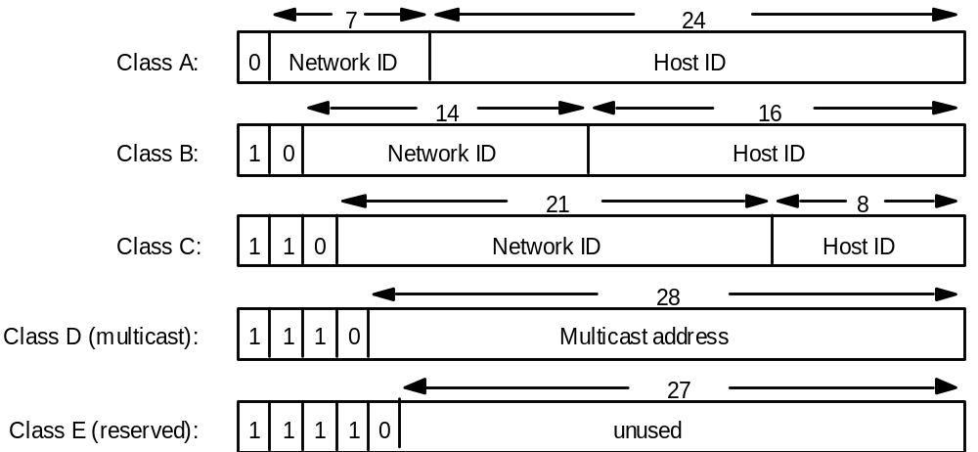
Figure 3.15 IP addresses (bits)
Coulouris et al

Slide 13
Figure 3.16 IP addresses (decimal)
octet 1
octet 2
octet 3
Range of addresses
Network ID
Host ID
Class A:
1 to 127
0 to 255
0 to 255
0 to 255
1.0.0.0 to
127.255.255.255
Network ID
Host ID
Class B:
128 to 191
0 to 255
0 to 255
0 to 255
128.0.0.0 to
191.255.255.255
Network ID
Host ID
Class C:
192 to 223
0 to 255
0 to 255
1 to 254
192.0.0.0 to
223.255.255.255
Multicast address
Multicast address
Class D (multicast):
224 to 239
0 to 255
0 to 255
1 to 254
224.0.0.0 to
239.255.255.255
Class E (reserved):
240 to 255
0 to 255
0 to 255
1 to 254
240.0.0.0 to
255.255.255.255
Coulouris et al

Slide 14
Socket Address (IPv4)
A socket address on the TCP/IP internet consists of two parts:
An internet (IP) address, a 32 bit number usually represented by 4 decimal number separated by dots. It is a unique identifier for a network interface card within an administered AF_INET domain. A TCP/IP Host may have as many addresses as it has network interfaces. (Newer IP addresses have 6 decimal numbers)
A 16 bit port number, which is an entry point to an application that resides on a host. Port define entry points for services provided by server applications. Important commercial applications such as Oracle have their own well known ports.

Slide 15
IP Protocol Approach
Define functions that support network communications in general, and use parameters to make TCP/IP communication a special case.
Socket calls refer to all TCP/IP protocols as a single protocol family.

Slide 16
IP Protocol
The IP protocol transmits datagrams from one host to another with unreliable or best-effort semantics. Delivery is not guaranteed.
The IP layer puts datagrams into packets suitable for transmission in the underlying network, such as Ethernet.
It must also inform the underlying network of the address of the message destination using address resolution.

Slide 17
Address Resolution
The address resolution module must convert an internet address so that it can be understood by the underlying network. For example, the 32 bit IPv4 address has to be converted to a 48 bit Ethernet address on an Ethernet network.
This process is specific for each network, and network addressing schemes do not correlate directly to one another. Typically, known address resolutions will be cached, while new addresses are found by querying each node on the network.

Slide 18
Classless Interdomain Routing (CIDR)
In 1996, due largely to the allocation of class B network addresses to small networks, the Internet began to run out of addresses. Network administrators who could not be certain that their network would not grow past 255 nodes used class B addresses instead of Class C.
The CIDR scheme was developed to allow a series of contiguous class C addresses to be used for a subnet requiring more than 255 addresses. This also allowed existing Class B addresses to be subdivided.

Slide 19
CIDR Routing Tables
CIDR required redesign of the routing tables to avoid inefficiency, since a former class B network address might now represent many widely separated CIDR networks.
The solution was to add a mask field to a routing table. The mask is used to select the portion of the IP address that is to be used to select the network identifier as opposed to the node identifier.

Slide 20
Unregistered Addresses
All of the computers and devices that access the Internet do not need globally unique IP addresses. Computers that are attached to a local network and access the Internet through a router can use the router to redirect packets to the correct computer.
For example, the instructor’s home network is connected through a router to a cable modem to an Internet provider. The single globally unique IP address provided by the Internet service is the address of the cable modem, and is shared by the four computers on the home network.

Slide 21
Network Address Translation
Unregistered internal Internet enabled devices are assigned addresses, usually by the Dynamic Host Configuration Protocol (DHCP). Normally, small networks are assigned addresses on the 192.168.1.x class C subnet, while larger networks use either the 10.z.y.x. class A subnet or the 172.16.y.x Class B subnet.
NAT enabled routers maintain an address translation table and use available source and destination port numbers to assign packets to local nodes.

Slide 22
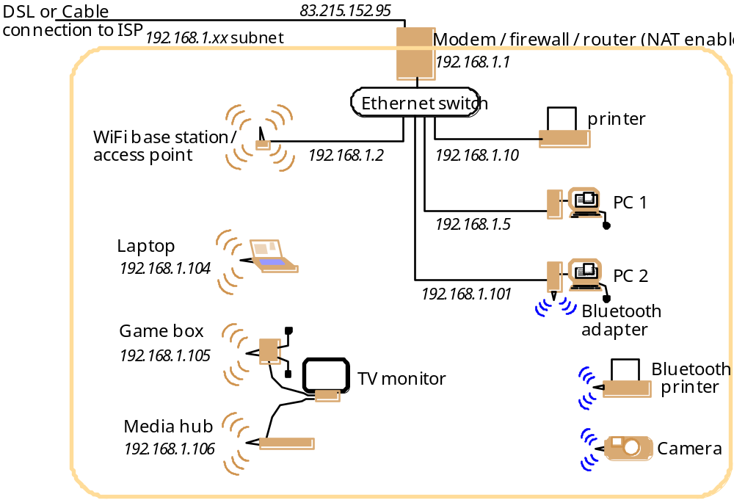
Figure 3.18 A Home Network
Coulouris
et al

Slide 23
IPv6
In 1994, IPv6 was adopted as a more permanent solution to the shortage of IP addresses and migration to it over a period of time was recommended.
IPv6 contains not only a much larger address space, but also provisions desired by large Internet service providers. Some of these are controversial, such as the ability to assign classes to packets, so a provider can give a higher quality of service to its own subscribers than to transient traffic on its network.

Slide 24
New IPv6 Provisions
Larger address space
Partitioned address space
Reduced header complexity for faster routing
Traffic class and flow label headers to identify traffic for special handling, such as a multimedia stream
The IPv6 header format is shown on the next slide.

Slide 25
Figure 3.19 IPv6 Header
Version (4 bits)
Traffic class (8 bits)
Flow label (20 bits)
Payload length (16 bits)
Next header (8 bits)
Hop limit (8 bits)
Source address
(128 bits)
Destination address
(128 bits)
Coulouris et al

Slide 26
Connection Oriented Protocols
Also known as session-based protocols, virtual circuits, or sequenced packet exchanges.
Provide reliable two-way connection service over a session.
Packets are given unique sequence numbers.
Delivered packets are individually acknowledged.
Duplicated packets are detected and discarded.

Slide 27
Connection Oriented Protocols
Connection-oriented protocols operate in three phases.
  The first phase is the connection setup phase, during which the corresponding entities establish the connection and negotiate the parameters defining the connection.
  The second phase is the data transfer phase, during which the corresponding entities exchange messages under the auspices of the connection.
  Finally, the connection release phase is when the correspondents "tear down" the connection because it is no longer needed.

Slide 28
TCP/IP
TCP/IP is a family of protocols.
TCP/IP is built on "connectionless" technology. Information is transferred as a sequence of "datagrams".
Generally, TCP/IP applications use 4 layers:
  An application protocol such as mail .
  A protocol such as TCP that provides services need by many applications.
  IP, which provides the basic service of getting datagrams to their destination .
  The protocols needed to manage a specific physical medium, such as Ethernet or a point to point line.

Slide 29
Cost of Session Oriented
Reliable service has an overhead cost. You must create and manage the session.
A lost session must be reestablished by one of the parties, a problem for fault tolerant servers that switch automatically to backup.
Sessions are a two party affair, and not well suited to broadcasting.

Slide 30
Basic I/O Functions in UNIX
Sockets extend these basis I/O functions:
  open
  close
  read (see also recv and recvfrom)
  write (see also send and sendto)
  lseek
  ioctl

Slide 31
Using I/O in UNIX
int desc;
...
desc = open(“file”, O_RDWR, 0);
read(desc, buffer, 128);
…
close(desc);

Slide 32
Using UNIX I/O with TCP/IP
They extended the conventional UNIX I/O facilities
It became possible to use file descriptors for network communication
Extended the read and write system calls so they work with the new network descriptors.

Slide 33
Descriptor Table
Internal data structure
for file 0
0
1
2
...

Slide 34
Internal data structure
for file 0
0
1
Family: PF_INET
2
Service: SOCK_STREAM
Local IP:
...
Remote IP:
Local Port:
Remote Port:
...

Slide 35
Passive/Active Socket
A passive socket is used by a server to wait for an incoming connection.
An active socket is used by a client to initiate a connection.

Slide 36
Sockets
When a socket is created it does not contain information about how it will be used.
TCP/IP protocols define a communication endpoint to consist of an IP address and a protocol port number.

Slide 37


Sockets
Figure A
Figure B

Slide 38
Server Process
UNIX
version
Server Process
socket()
bind()
socket()
listen()
TCP
bind()
UDP
accept()
Client Process
recvfrom()
get a blocked client
Client Process
socket()
1
get a blocked client
socket()
read()
connect()
2
bind()
procees request
process request
write()
sendto()
write()
3
sendto()
read()
recvfrom()

Slide 39
Server Process
Winsock
or Unix
version
Server Process
socket()
bind()
socket()
listen()
TCP
bind()
UDP
accept()
Client Process
recvfrom()
get a blocked client
Client Process
socket()
1
get a blocked client
socket()
recv()
connect()
2
bind()
process request
process request
send()
sendto()
send()
3
sendto()
recv()
recvfrom()

Slide 40
TCP vs. UDP
TCP (Transmission Control Protocol)
  Connection-oriented
  Reliability in delivery of messages
  Splitting messages into datagrams
  keep track of order (or sequence)
  Use checksums for detecting errors

Slide 41
TCP vs. UDP (Cont’d)
UDP (User Datagram Protocols)
  Connectionless
  No attempt to fragment messages
  No reassembly and synchronization
  In case of error, message is retransmitted
  No acknowledgment

Slide 42
Datagrams
Also known as connectionless or transmit and pray protocols.
Simple, but unreliable. They are not tracked by sequence number or acknowledged.
NetBIOS and some others provide broadcast capability.
LAN Server and some others have acknowledged datagrams.

Slide 43
Datagrams
A datagram, often called a packet, is much more atomic in nature.
A datagram is an independent, self-contained message sent over the network whose arrival, arrival time, and content are not guaranteed.
All data sent over the channel is received in the same order in which it was sent. This is guaranteed by the channel.
In modern data networking, it is important to distinguish between datagrams and streams.

Slide 44
Datagram Uses
Good for discovery - is someone listening?.
Broadcast applications - a form of network “junk mail”.
Dynamic environments where name of recipient is unknown.
Quick messages (“The network is up”) where it is not critical that the message be received.

Slide 45
Selecting UDP
Remote procedures are idempotent*
Server and client messsages fit completely within a packet.
The server handles multiple clients (UDP is stateless)
*a mathematical operation that always produces the same result

Slide 46
Selecting TCP
Procedures are not idempotent
Reliability is a must
Messages exceed UDP packet size

Slide 47
IP (Raw) Socket
To use RAW sockets in Unix it is mandatory that one have root authority. To create a RAW socket write:
s=socket(AF_INET,SOCK_RAW,[protocol])
Then you can sending or receive over it. Raw sockets are used to generate / receive packets of a type that the kernel doesn't explicitly support.

Slide 48
IP Socket example
A familiar example is PING. Ping works by sending out an ICMP (internet control message protocol - another IP protocol distinct from TCP or UDP) echo packet. The kernel has built-in code to respond to echo/ping packets. It doesn't have code to generate these packets, because it isn't required. The "ping packet generator" is a program in user space. It formats an ICMP echo packet and sends it out over a SOCK_RAW, waiting for a response.

Slide 49
OSI Layers vs. TCP/IP
User
Application
5-7. Session
4. Transport
TCP
UDP
3. Network
IP
1-2. Data Link/
Physical
Hardware
Interface
Network

Slide 50
Four Types of Servers
Iterative
Connection-
Oriented
Iterative
Connectionless
Concurrent
Connectionless
Concurrent
Connection-
Oriented

Slide 51
Summary
Algorithms for TCP and UDP Clients and Servers

Slide 52
TCP Client Algorithm
Comer and Stevens, Algorithm 6.1
Find IP address and protocol port number on server
Allocate a socket
Allow TCP to allocate an arbitrary local port
Connect the socket to the server
Send requests and receive replies
Close the connection

Slide 53
TCP Iterative Server Algorithm
Comer and Stevens, Algorithm 8.1
Create a socket and bind to the well known address for the service offered
Place socket in passive mode
Accept next connection request and obtain a new socket
Repeatedly receive requests and send replies
When client is done, close the connection and return to waiting for connection requests

Slide 54
TCP Concurrent Server Algorithm
Comer and Stevens, Algorithm 8.4
Master:
  Create a socket and bind to the well known address for the service offered. Leave socket unconnected
  Place socket in passive mode
  Repeatedly call accept to get requests and create a new slave thread
Slave:
  Receive connection request and socket
  Receive requests and send responses to client
  Close connection and exit

Slide 55
UDP Client Algorithm
Comer and Stevens, Algorithm 6.2
Find IP address and protocol port number on server
Allocate a socket
Allow UDP to allocate an arbitrary local port
Specify the server
Send requests and receive replies
Close the socket

Slide 56
UDP Iterative Server Algorithm
Comer and Stevens, Algorithm 8.2
Create a socket and bind to the well known address for the service offered
Repeatedly receive requests and send replies

Slide 57
UDP Concurrent Server Algorithm
Comer and Stevens, Algorithm 8.3
Master:
  Create a socket and bind to the well known address for the service offered. Leave socket unconnected
  Repeatedly call recvfrom to get requests and create a new slave thread
Slave:
  Receive request and access to socket
  Form reply and send to client with sendto
  Exit

Slide 58
Named Pipes
An Alternative to Sockets

Slide 59
Named Pipes
Named Pipes are a file system from which the kernel can assign data blocks or memory spaces.
They provide a file-like programming API for session-based two way exchange of data.
Exchange data as if reading from or writing to a file.
Good for many-to-one server programs, with scheduling and synchronization.
Part of the base interprocess communications service for Windows.
Provided on Unix by LAN Manager/X.

Slide 60
Code fragment: Named Pipes
Char string[]=“Hello”;
main(argc, argv)
int argc;
char* argv[];
int fd;
char buf[256];
mknod(fifo”,010777,0) /* Create Pipe RW=all*/
if (argc==2)
fd = open(“fifo”, 0_WRONLY;
else
fd = open(“fifo”, 0_RDONLY);
for (;;)
if (argc==2)
write (fd, string, 6);
else
rd (fd, buf, 6);

Slide 61
References
Robert Orfali, Dan Harkey, Jeri Edwards, Client Server Survival Guide, Third Edition, Wiley, 1999.
Douglas E. Comer and David L. Stevens, Internetworking With TCP/IP, Volume III, Prentice Hall, multiple editions and dates.
George Coularis, Jean Dollimore and Tim Kindberg, Distributed Systems, Concepts and Design, Addison Wesley, Fourth Edition, 2005
Figures from the Coulouris text are from the instructor’s guide and are copyrighted by Pearson Education 2005

